Slide 1
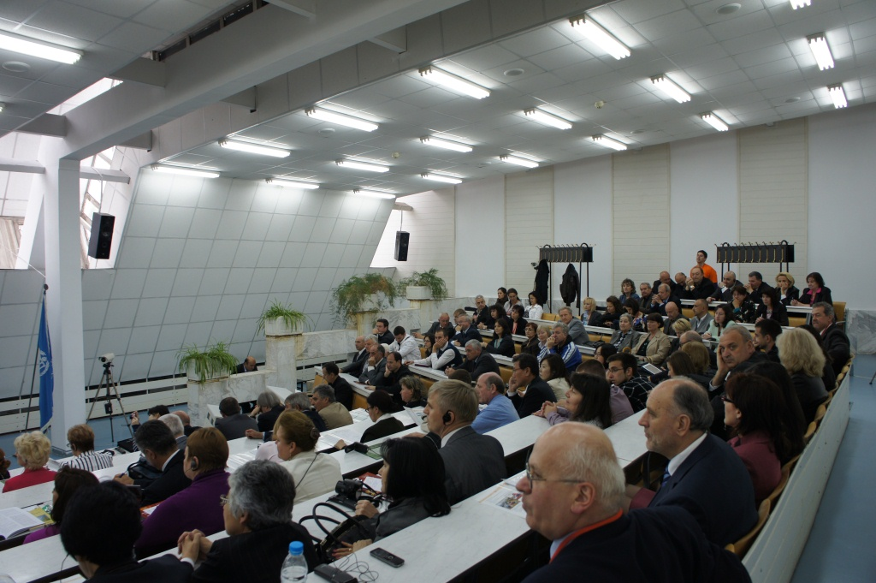
International Scientific Conference

Slide 2
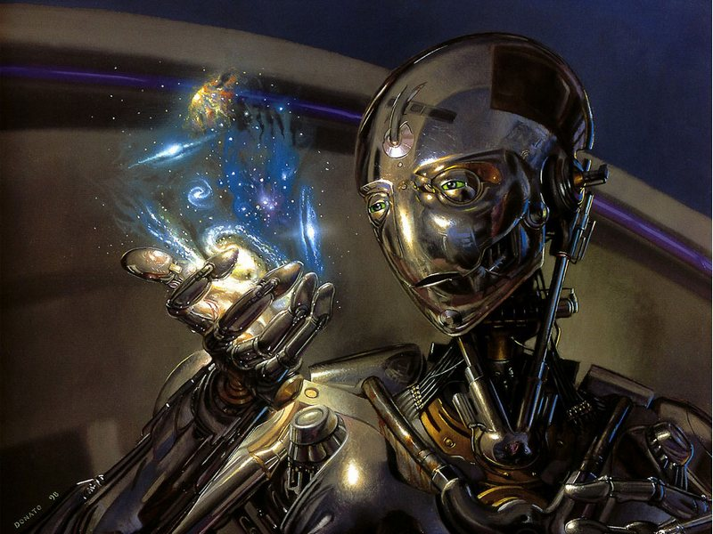
“The march of invention has clothed mankind with powers of which a century ago the boldest imagination could not have dreamt”.
Henry George

Slide 3
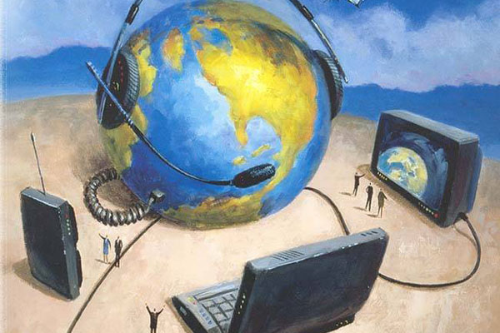
1. To mail the letter 6. To SMS friends
2. To check the e-mail 7. To listen to music
3. To text messages 8. To download music
4. To leave a message 9. To visit chat rooms
5. To log on a site 10. To run websites

Slide 4

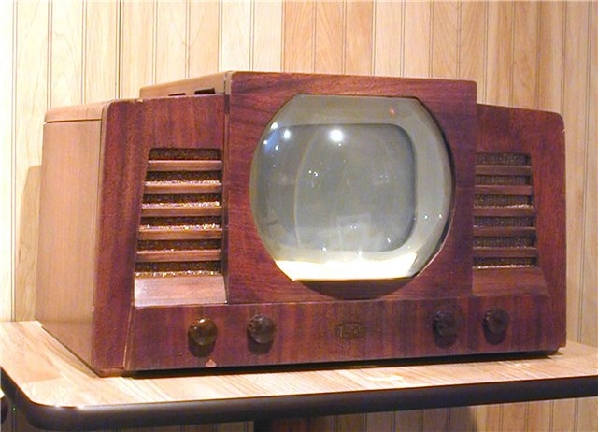
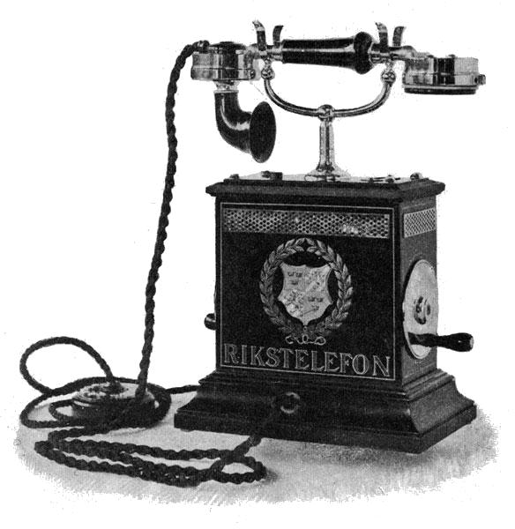
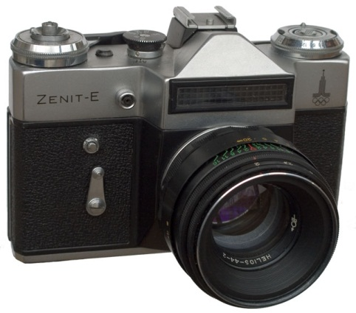
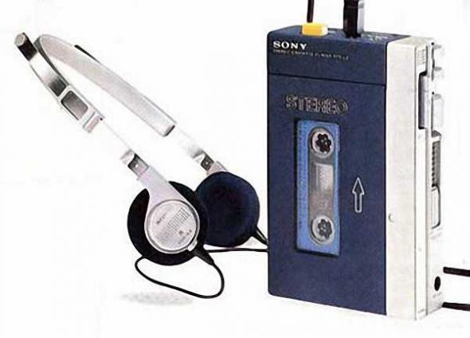
In 1876 Alexander Graham Bell, an American engineer, invented …
Akito Morita (Japan) developed the first …
In 1908 James M. Spangler from the USA built the first …
John Logie Baird from Scotland invented …
Nicephore Niepce from France invented … in 1829.
television
photography
vacuum cleaner
personal stereo – Sony Walkman.
telephone

Slide 5
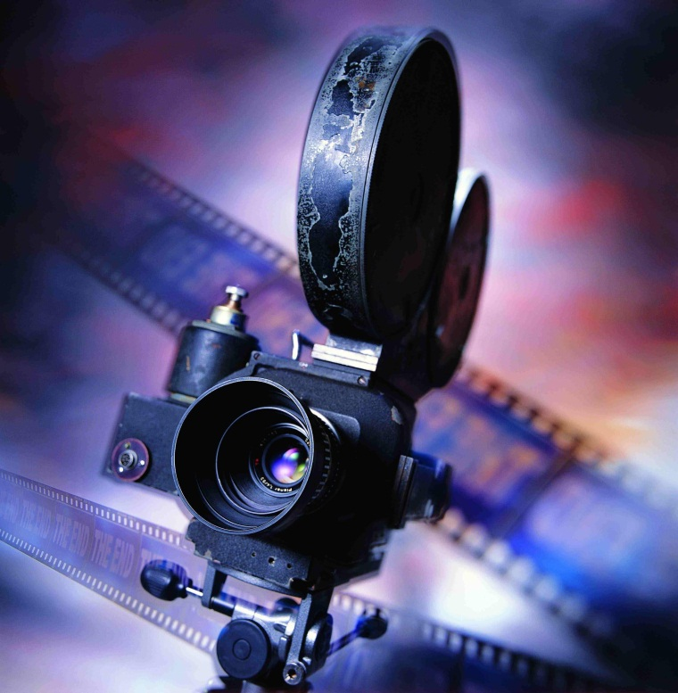

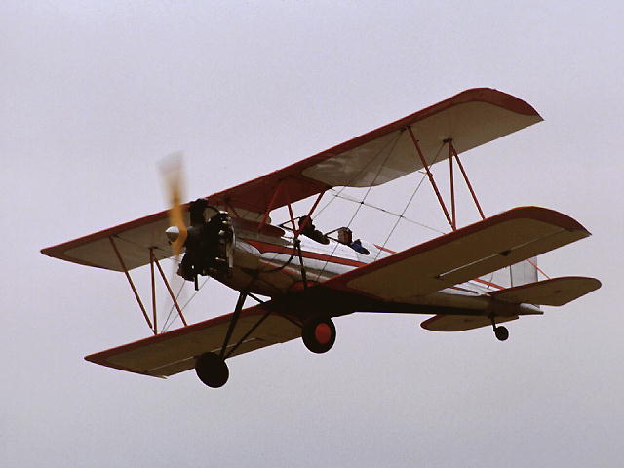
In 1981 Bill Gates (USA) created … (Disk Opening System).
-Wilbur and Orville Wright built the first …in 1903 (USA).
-In 1895 the Luimiere brothers patented their …and opened the world’s first cinema in Paris.
Microsoft-Dos (Disk
Opening System)
airplane
cinematography

Slide 6
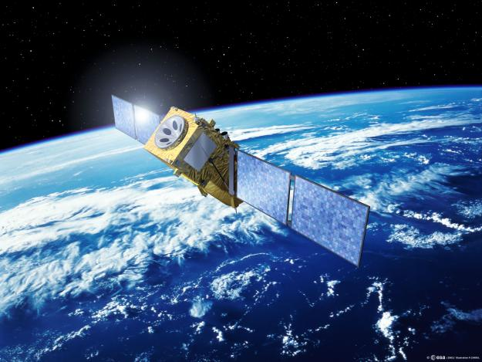
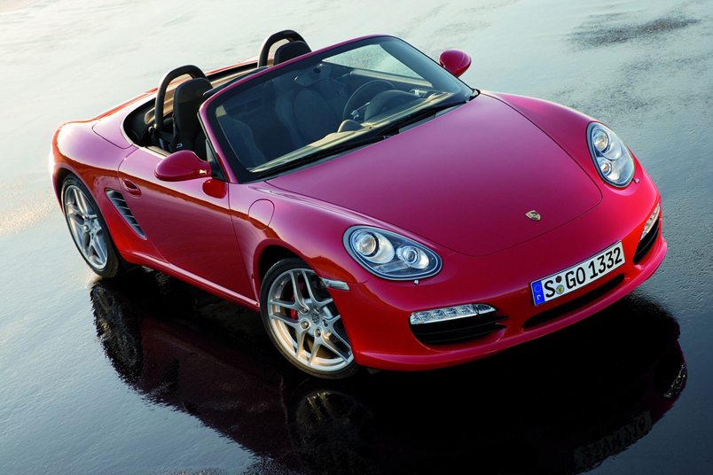
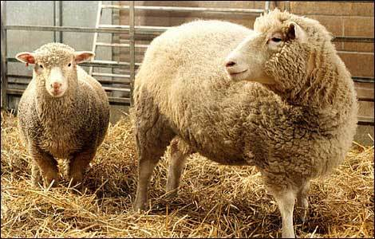
- Scottish scientist Ian Wilmat developed … in 1997.
- Karl Benz produced the world’s first … in Germany in 1885.
- Sergey Korolev (Russia) designed the first … in 1957.
the idea of cloning
artificial satellite
petrol- driven motor car

Slide 7

-I think that … is the most important thing.
-We can…
-Some of inventions, for example, are less important.
-We do often …
-And I’m sure we can do without …

Slide 8
Device | For | Against
Computer
Car
Phone

Slide 9
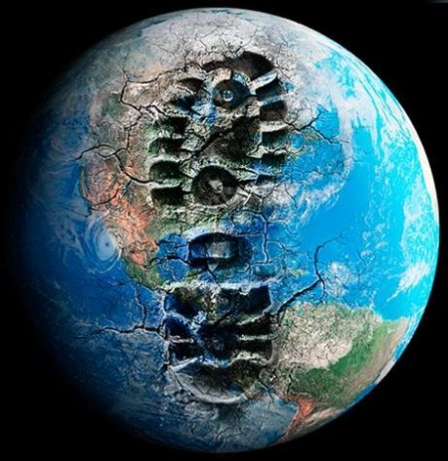
Useful language
On the one hand…
It’s true that…
Moreover,…
However,…
On the second hand…
In conclusion…

